Slide 1
My Zero to one!
Johnny Nguyen

Slide 2
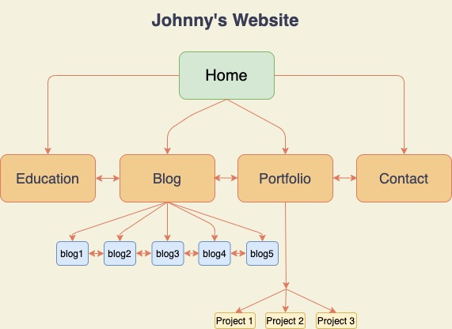
Sitemap – Overview
Structure:
A total of 5 HTML pages
Accessibility:
A navbar located on top of each page
Blog page:
5 blogs
Accessible via the same page
Portfolio page:
3 projects using flip animation for description of each project.

Slide 3
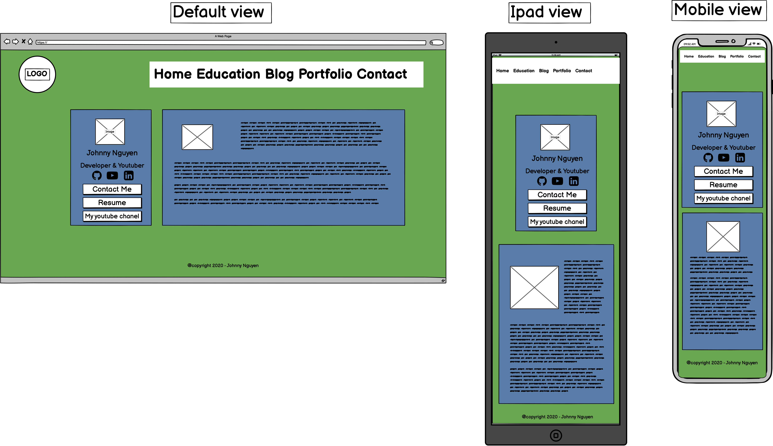
Wireframes Mockups - Home page
Design
2 separated sheets, 1st one with profile photos, contact buttons. 2nd one with text description
Color: Background of 3d dark green theme
Container: dark them
Text : white
List of components:
Flexbox , logo image
Hover
Linear gradient color (a mixture of 2)
Keyframes
Font-Awesome
Link to external Resume file

Slide 4
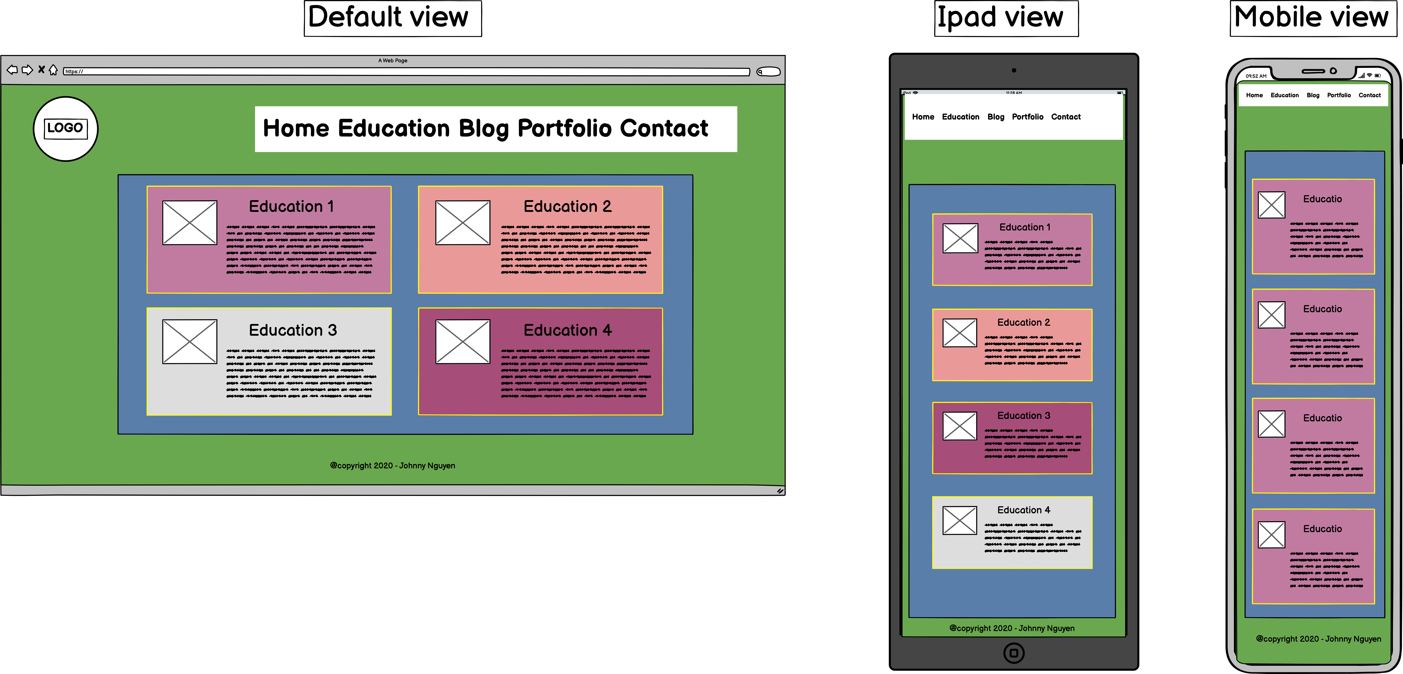
Wireframes Mockups - Education page
Design
2 separated sheets, 1st one with profile photos, contact buttons. 2nd one with text description
Color: Background of 3d dark green theme
Container: dark them
Text : white
List of components:
Flexbox , logo image
Hover
Box shadow effects
Nth child() selector

Slide 5
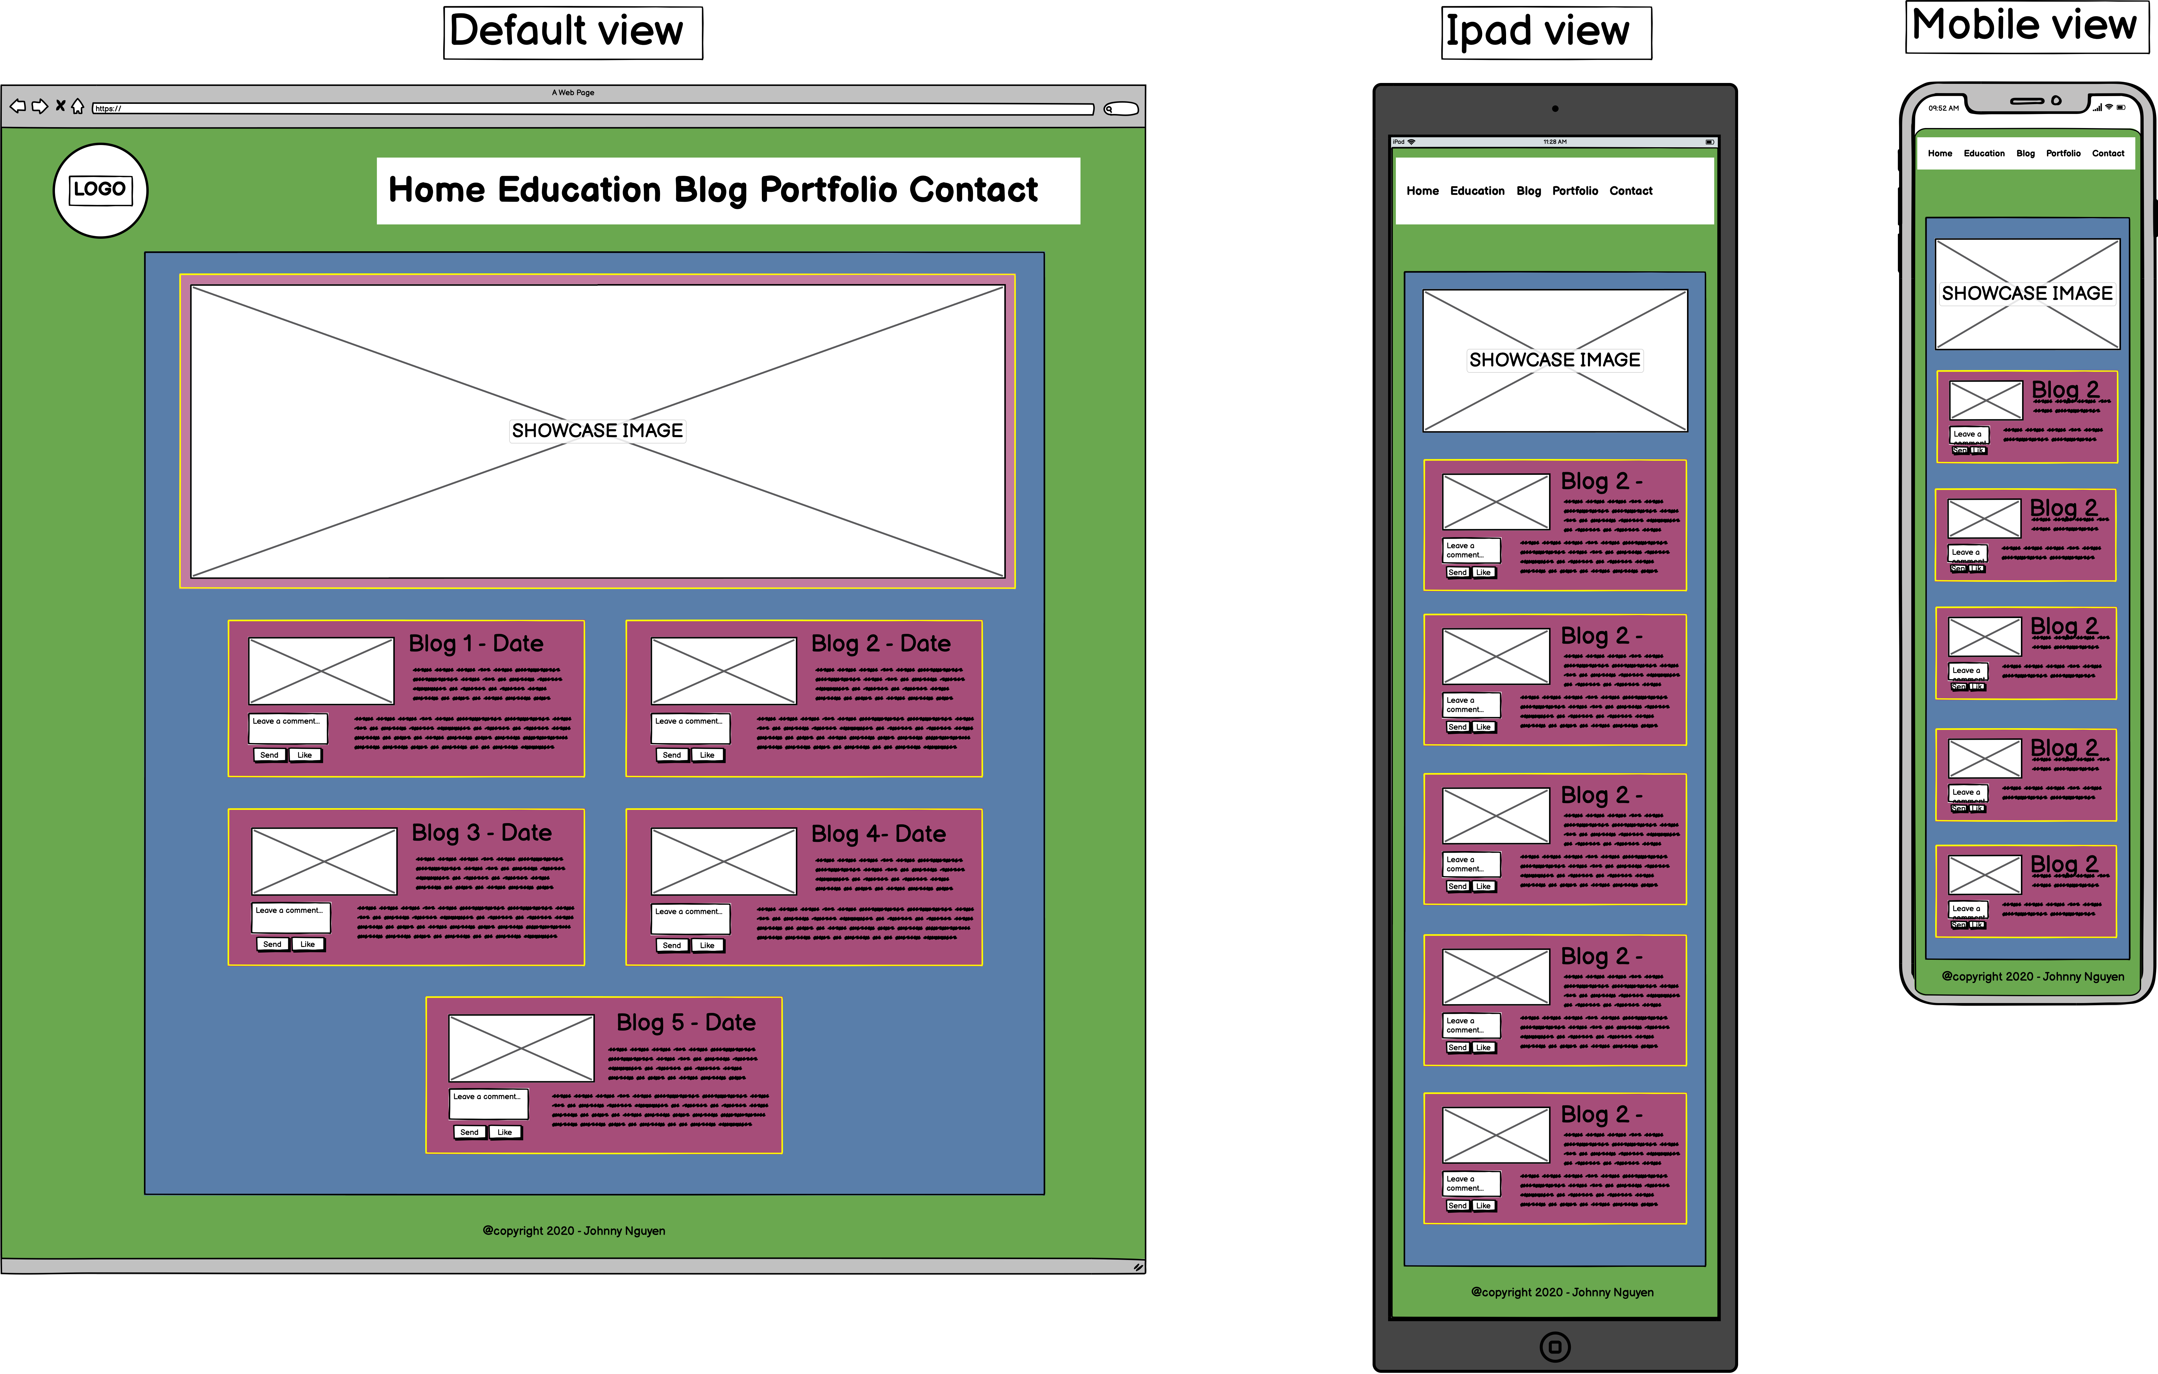
Wireframes Mockups - Blog page
Design
1 showcase photo
5 sub-containers for each blog
Text : white
Each blog shows content, feedback and like button
List of components:
Flexbox , blog images
Hover, image transformation, scaling
Box shadow effect
Form, text input, submit button

Slide 6
Wireframes Mockups - Portfolio page
Design
3 separated cards, each show 1 individual project
Front : Image, Name, Skills
Back : Description, date & time, read more button to explore further
Dark theme, white text
List of components:
Flexbox , flex-wrap, flex-direction
Flip-card animation
Link to external websites
Font-awesome

Slide 7
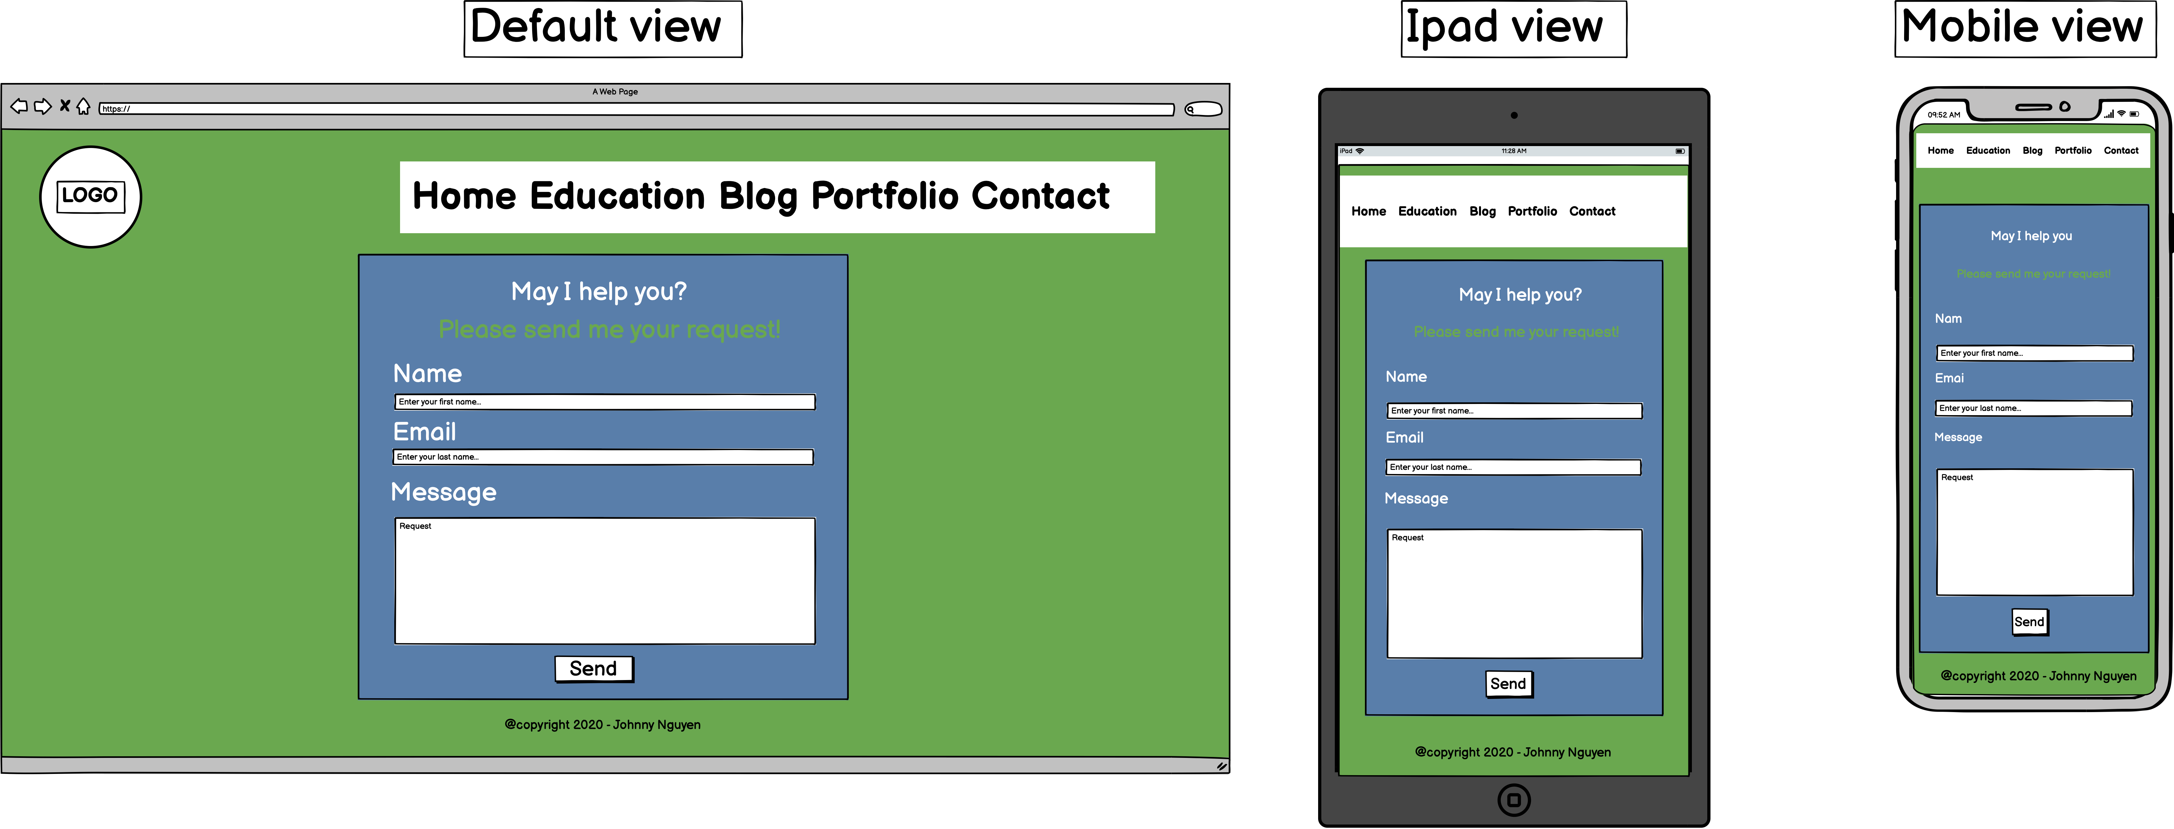
Wireframes Mockups - Contact page
Design
1 single sheet
Ask viewer to input their name, email and requests
Container: dark theme
Text : white
List of components:
Flexbox , logo image
Send button
Box shadow effects
Text area input

